Slide 1

Architecture
for Agents
A hands-on hour. Open your laptop: you are building your own AI Second Brain with me, not watching me build one.
BRING: A LAPTOP · CLAUDE · OBSIDIAN IF YOU HAVE IT
MeshPro × Expectus
Notes:
Set the rule in the first ten seconds: laptops open, we do this together, nobody watches. Anyone without Obsidian can still do every step.

Slide 2

THE NEXT HOUR
What you will have when you leave
Not a demo you watched. A thing on your own laptop, with your own work in it, that keeps working on Monday.
A place your work lives
Assistants that know your job
A page that will not flatter you
Your accounts, your promises, your half-finished drafts — written once, in plain text you own, instead of re-typed into a chat window every morning.
One per department — one per part of your job. Each knows what it is responsible for, and — the part that matters — where it stops.
Rebuilt from your notes every time. It names what is waiting on you and how long it has been waiting.
Everything you build today is yours, on your own machine, and none of it needs us afterwards.
02
Notes:
Keep this personal. Nobody in the room is being asked to reorganise their employer. They are being asked to make their own week easier.

Slide 3

THE IDEA
This is not being built for you.
It is being built for the agents.
Your vault is not a nicer set of notes. It is a structure an LLM can read, navigate and act on — written in the shape a machine needs, which happens to also be readable by a person.
ONE HOME
FIELDS, NOT PROSE
THE GRAPH
A fact lives in one place
Every note is labelled
Linked, never copied
So an agent never has to choose between two versions of the truth — and neither do you.
Plain-text fields it can filter, count and reason over, instead of guessing from prose.
The graph is how it finds context. Copy-paste breaks it; a link makes it navigable.
03
Notes:
This is the line that separates this from note-taking advice. Say it plainly: we are writing for the agents. A human-friendly vault is a side effect of a machine-readable one, not the goal.

Slide 4
THE ONE TOOL WORTH HAVING
Obsidian: your vault, and why it is worth the five minutes
Obsidian does not store anything. It reads the folder. Most of you already have it — if you do not, you can still do every step today.
WHAT IT GIVES THE AGENTS
IF YOU SKIP IT TODAY
Retrieval that actually works
Everything still works
Backlinks and the graph turn your notes into something an agent can walk: from a client, to the promise, to the workflow that delivers it.
Plus the plugin shelf — Dataview and the rest — which lets a page answer a question instead of just sitting there.
The vault is plain Markdown. Notepad opens it, Claude reads and writes it, every step in this hour runs.
What you lose is the retrieval side: the graph links, the backlinks and the plugins. Install it tonight and nothing has to be redone.
04
Notes:
Say the skip clause out loud early so nobody stalls here downloading software. The honest trade is retrieval quality, not whether it works at all.

Slide 5
SIXTY SECONDS
Before we start
—
Claude, on your laptop
The desktop app, signed in. This is where every step happens.
—
Somewhere to put a folder
Documents is fine. It will be empty when we start.
—
Obsidian, if you have it
Optional. Five minutes to install if you want it now — or tonight.
—
Nothing else
No Python, no terminal, no account to create, no plugin to buy.
05
Notes:
Give the room a real minute here. Everything after this assumes Claude is open. Walk round if you have to — a stalled laptop at step one stays stalled all hour.

Slide 6
HANDS ON
1
Make the folder
DO THIS NOW
Make an empty folder under C:\AI and name it after yourself or your team — C:\AI\My Second Brain is a fine answer.
You will know it worked when the folder exists and is empty. That is genuinely all of step one.
WHY A FOLDER AND NOT AN APP
Because you keep it
Everything today is plain text files in this folder. No database, no account, nothing hosted. If we never speak again it still opens — and you can read every file of it in Notepad.
06
Notes:
Watch for people over-thinking the name. Any name. Move on fast — the next two steps are where questions come.

Slide 7
HANDS ON
2
Open it in Obsidian
DO THIS NOW
In Obsidian choose Open folder as vault, and pick the folder you just made. If you do not have Obsidian, skip this and carry on.
You will know it worked when Obsidian shows an empty vault with your folder's name in the corner.
It is now a vault
Leave it open beside Claude
Same folder, nothing moved or converted. “Vault” is just Obsidian's word for a folder it is watching.
For the rest of the hour you will watch notes appear in Obsidian as Claude writes them. That is the whole demo, really.
07
Notes:
Tell them to tile the two windows — Claude on the left, Obsidian on the right. Seeing files appear as Claude works is the moment people understand what this is.

Slide 8
HANDS ON
3
Make a project, and connect the folder
DO THIS NOW
In Claude, create a project and name it after your work. Then connect the folder you just made to that project and approve it.
You will know it worked when Claude tells you the folder is connected and can list what is in it — nothing.
WHY A PROJECT AND NOT A NORMAL CHAT
Because a project remembers
Every conversation inside it reads and writes the same folder. Next week starts where today ended instead of starting from nothing — which is the thing that has been annoying you every morning.
08
Notes:
This is the step that fails for people. Stay here until every laptop in the room says connected. The approval dialog is easy to miss.

Slide 9
HANDS ON
4
Ask for the setup
DO THIS NOW
Type the sentence below into your project. Then watch Obsidian.
You will know it worked when Claude reports back what it made — folders, a contract, working agents, workflows and a four-page site.
Set up the AI Operations Framework in my connected folder.
Pull it from github.com/MeshPro-iPaaS/ai-ops-framework and run the install.
It will ask you one question: what to call your executives. Job titles, Norse gods, Friends, the Kardashians — or three names of your own.
09
Notes:
Read the sentence out and put it in the chat so nobody mistypes the address. The naming question is the one bit of fun in the install — let the room shout answers. It takes about a minute. Tell them to watch the Obsidian pane while it runs — folders and notes appear one after another.

Slide 10
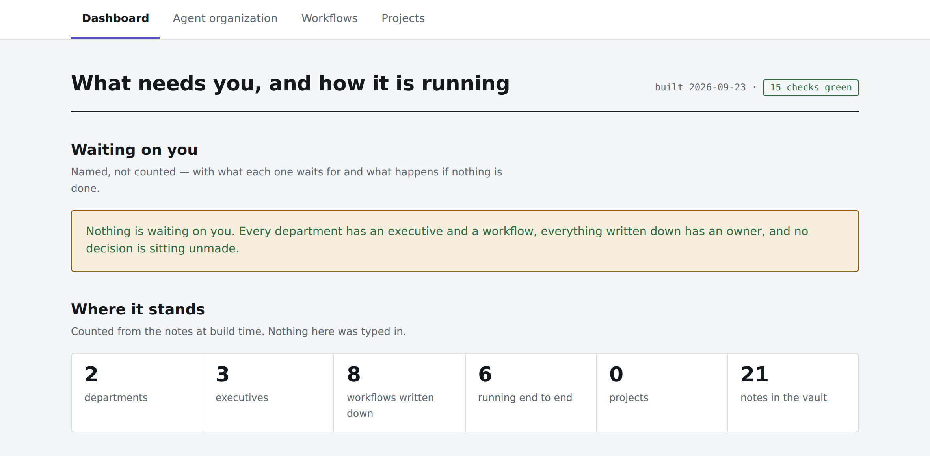
CHECKPOINT
Everyone should be looking at this
Four pages
Dashboard, agent organization, workflows, projects — tabs across the top.
Honest on day one
Two departments, three executives, and it says so. Not your job yet — that is next.
10
Notes:
Do not try to read this from the projector — everyone has it on their own screen, full size. Hold the room until hands are down. If somebody's check is red it will say why in plain language: read it out, it is a good advert for the next twenty minutes.

Slide 11
HANDS ON · THE REAL FIRST STEP
5
Name your departments
DO THIS NOW
Tell Claude: walk me through Setting Up a Department — my job has these parts, and then list them. Three to six.
You will know it worked when one note per department appears in Obsidian, each with an assistant attached to it.
WHAT COUNTS AS ONE
THREE TO SIX
Not a division of the company
Not twelve
The accounts you look after. The reporting. The LinkedIn posting. The thing you inherited that nobody else touches. If you answer for it, it is one.
If two of them would never disagree about anything, they are one department. You can add another next week in one sentence.
11
Notes:
Give this a full five minutes and walk the room. The twelve-department instinct is universal; push back. Ask two or three people to say theirs out loud — it unsticks everyone else.

Slide 12
THE PART WORTH UNDERSTANDING
Each one says where it stops — and that matters more than what it does
THE PROBLEM
THE FIX
An agent always answers
One line: what this is not
Ask one something just outside its ground and it does not say “that is not mine.” It produces something confident and plausible about a subject it knows nothing about — and the answer looks exactly like a good one.
Your Reporting department does not decide what to do about a bad number. Your Client Work department does not set prices.
Write that down and the assistant hands the question back instead of inventing one.
The stop line is what makes the other answers worth having. Without it you cannot tell a good answer from a confident one — and you will find out which it was later, in front of somebody else.
12
Notes:
This is the slide people will remember in a fortnight. Give a real example from your own work — a question you would not want an assistant guessing at.

Slide 13
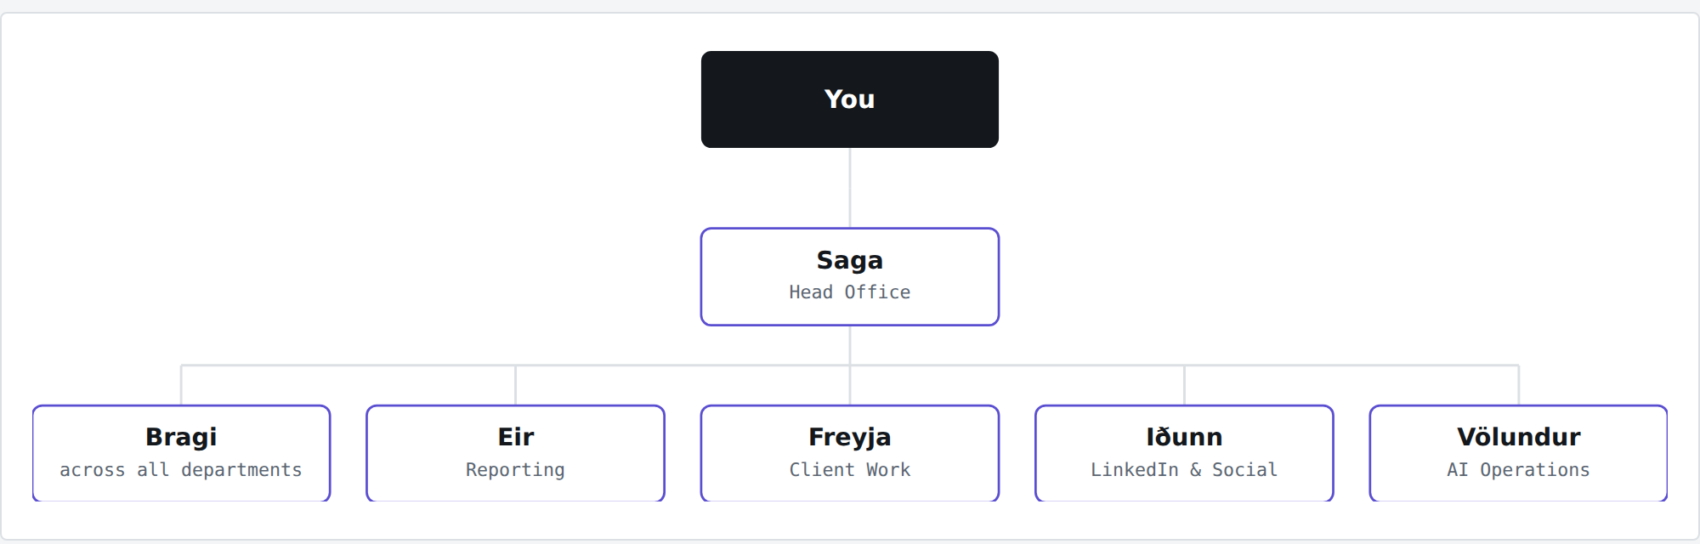
WHAT YOU JUST BUILT
That is an executive layer, and it is yours
Nobody drew this. It is read off each role note — who it reports to, which department it answers for — and redrawn every time the site is built.
Add a department with an executive next month — one sentence — and it appears here on the next build. There is no diagram to maintain.
13
Notes:
These names came from the Norse option at install — theirs will differ. Point at Bragi, across all departments: it owns how a workflow gets written down, not what any department does. It is the role nobody thinks to create.

Slide 14
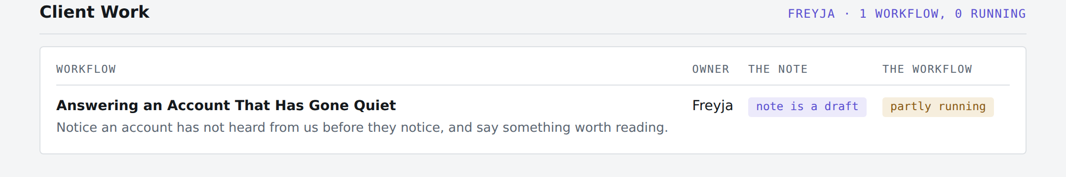
CHECKPOINT
Your workflows, in department blocks
Nobody typed these counts. They were counted off your own notes when the page was built.
ONE BLOCK PER DEPARTMENT
THE NUMBER TO LOOK AT
Everything lands somewhere
One workflow, none running
A workflow names its department or it fails the check. Nothing drifts into a pile nobody owns.
Uncomfortable, true, and you did not have to admit it. It was counted, not reported.
14
Notes:
Point at the zero. That is the whole value proposition in one number — counted rather than reported, so it cannot be quietly optimistic. Ask the room how many of their own written processes would survive that column.

Slide 15
HANDS ON · THE LAST ONE
6
Write down the thing that annoys you most
DO THIS NOW
Say: let's write down how [the thing] actually happens today, including the parts that are a mess. Then answer its questions.
You will know it worked when a workflow note exists with your steps in it — marked as a draft, and as not yet running.
PICK BADLY ON PURPOSE
TWO MARKS, NOT ONE
Not your most important process
Written down is not working
The one that goes wrong most often. That is where an assistant earns its place, and it is the one you will actually check.
Is the note true? Only after you have walked one real case through it. Does it run end to end? Different question. They fail separately, so they are tracked separately.
15
Notes:
Last hands-on block — leave ten minutes for it. If the room is running short, this is the one to send home as homework; everything before it is already done.

Slide 16
WHY YOU CAN TRUST IT IN A MONTH
It tells you when you are wrong
A hat with no assistant, and a workflow pointing at a hat that does not exist — a typo. Three seconds later:
FAILED: every department has exactly one executive who answers for it —
'Reporting' has no executive; every question about it lands back on you
FAILED: every workflow belongs somewhere — 'Posting on LinkedIn' belongs to
'LinkedIn and Socail', and there is no note by that name
No error code, no line number. It names the note and says what it costs you. That is why the page is still true in a month.
16
Notes:
Point out that it caught a typo — Socail — by name. Everyone has been burned by documentation that quietly went wrong; this is the answer to that.

Slide 17
MONDAY MORNING
What to do with it next week
—
Open the project, not a new chat
That is the whole habit. Everything else follows from it.
—
Add the one you forgot today
You will think of it on Tuesday. One sentence.
—
Write down the second annoying thing
One a week is a transformed job by Christmas.
—
Ask it what is waiting on you
On Friday. It will tell you, and it will be right.
It is your folder, on your laptop. Nothing here phones home.
Notes:
Send them away with one instruction, not four: open the project instead of a new chat. Everything else is downstream of that habit.

